Slide 1
Regression Models to Predict Progression of Parkinson’s
Bill Showers

Slide 2
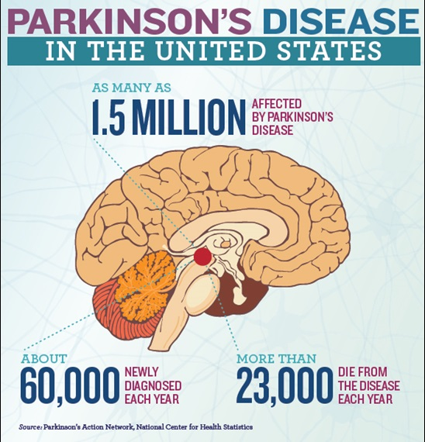
Background
Parkinson's: disorder affecting movement and speech
No cure
Vocal impairment is earliest symptom of disease, and manifests
Voice tremors, reduced loudness can be measured
Monitoring voice remotely would reduce clinic visits, and associated cost and inconvenience

Slide 3
Dataset: Vocal recordings of Early Onset
From the UC Irvine Machine Learning Repository
42 Patients monitored over time, 5875 unique observations
Sustained phonation test
Label: UPDRS Score (0: no disability, 199: complete disability)
22 Features
Sex (categorical)
All other features are numeric
Jitter (5 features) : variations in pitch of voice
Shimmer (6 features) : variations in volume of voice
NHR: Noise to harmonics ratio
HNR: Harmonics to noise ratio
PPE: Metric controlling for confounding variables in measurement of speech
DFA, RPDE: Nonlinear recurrence properties of sound

Slide 4
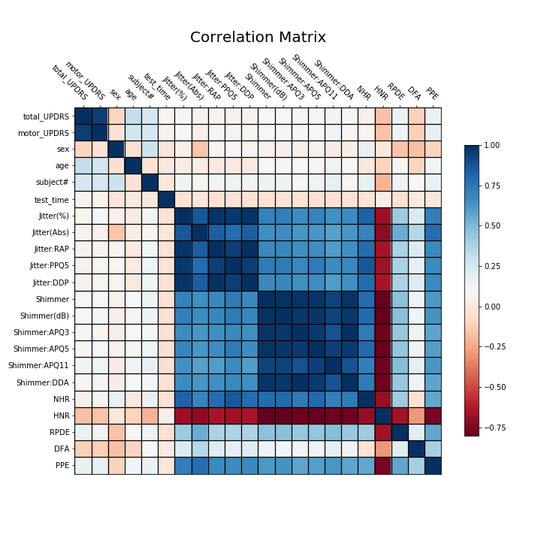
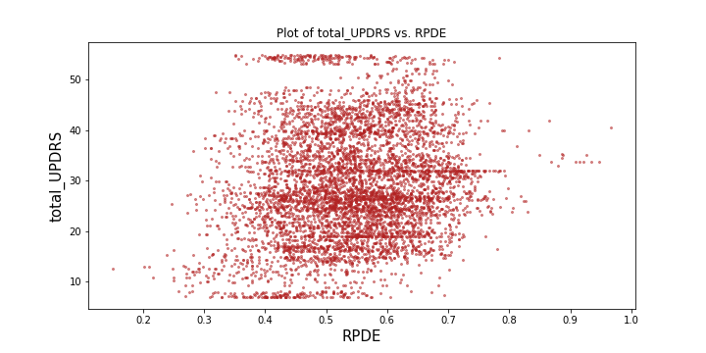
EDA

Slide 5
Data Cleaning
No missing values
Subject # should be dropped to avoid confusing models
test_time (time since diagnosis) will also be dropped

Slide 6
Models and Metrics To be Used
PCA + SVR
Decision Tree Regression
Random Forest
Lasso
Mean Squared Error (MSE)
R^2
Median Absolute Error (MAE)

Slide 7
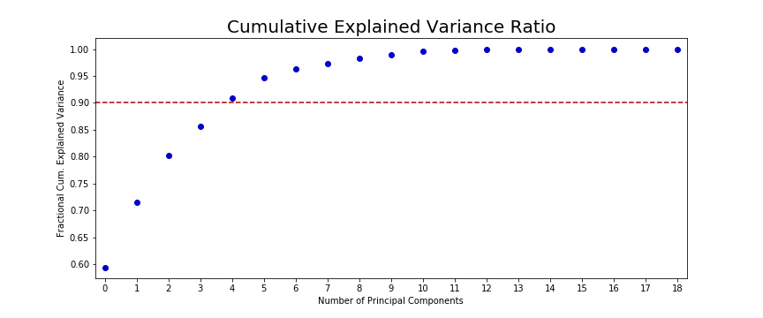
PCA + SVR

Slide 8
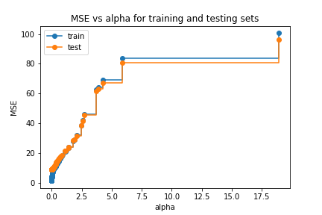
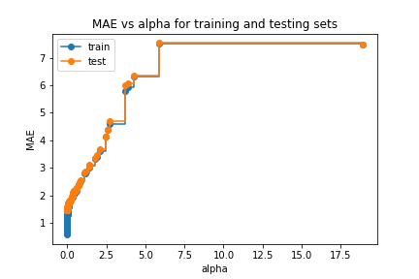
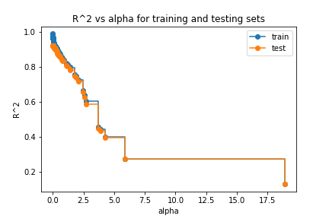
Decision Tree Regressor

Slide 9
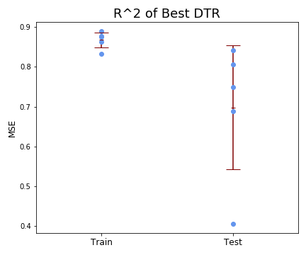
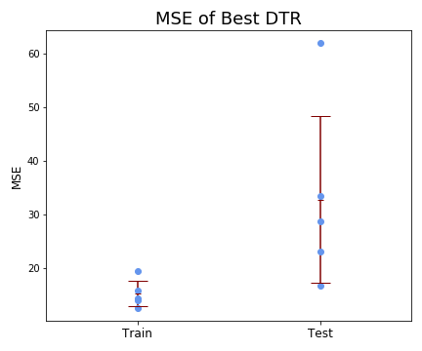
Best Decision Tree Regressor

Slide 10
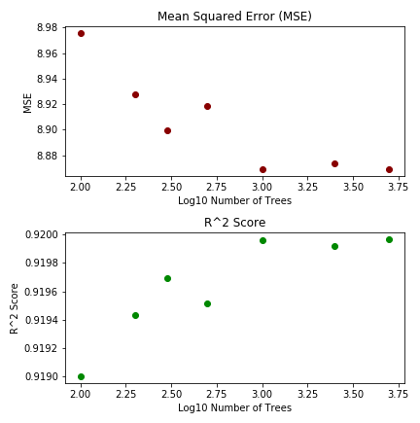
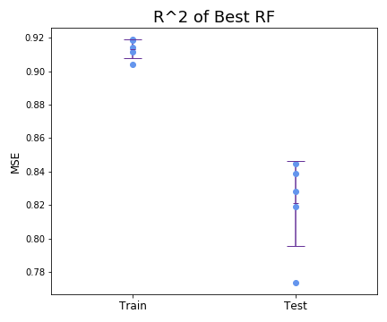
RandomForest Regression
Time required to fit trees for all ccp_alphas = 11 hours, 54 minutes

Slide 11
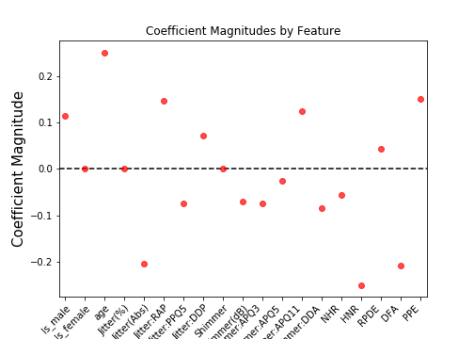
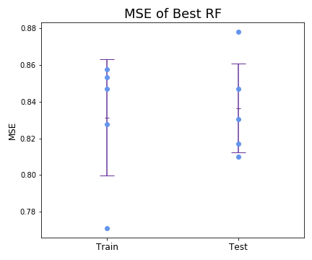
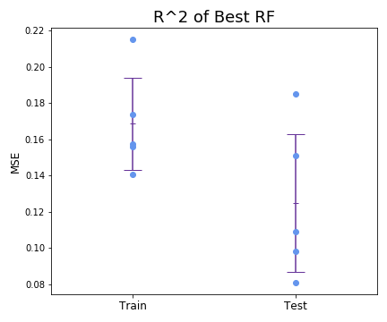
Lasso

Slide 12
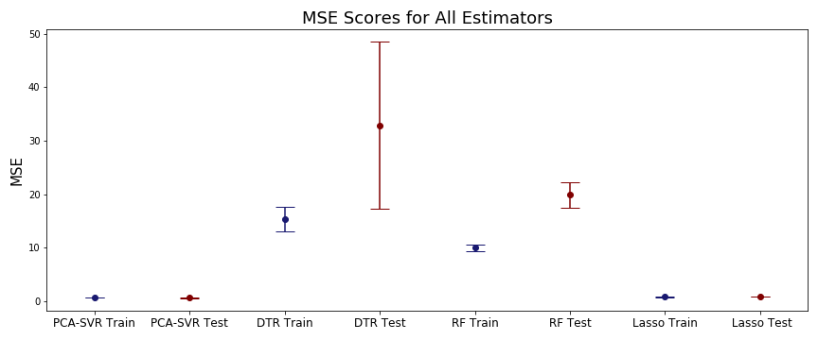
Model Comparison: MSE

Slide 13
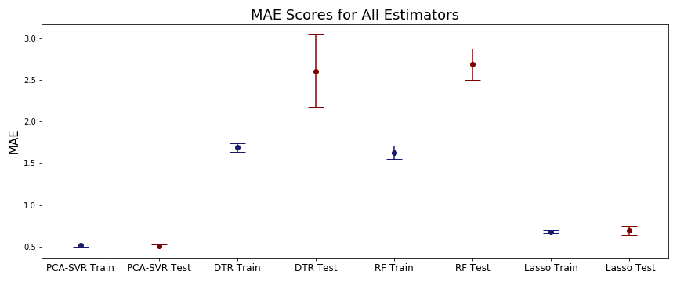
Model Comparison: MAE

Slide 14
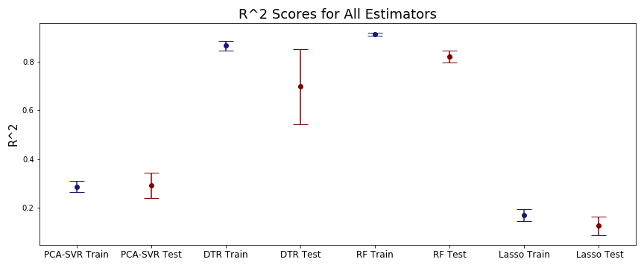
Model Comparison: R^2

Slide 15
Conclusion
R^2 metric is most accurate given scaling of features and label
Based on R^2, random forest is the best model
Randomforest and decision trees overfitted to data
Considerations for further analysis
Cost complexity pruning should be performed again with more processing speed
Scaling should be revisited
CNN could be performed on visualization of sound

